Slide 1
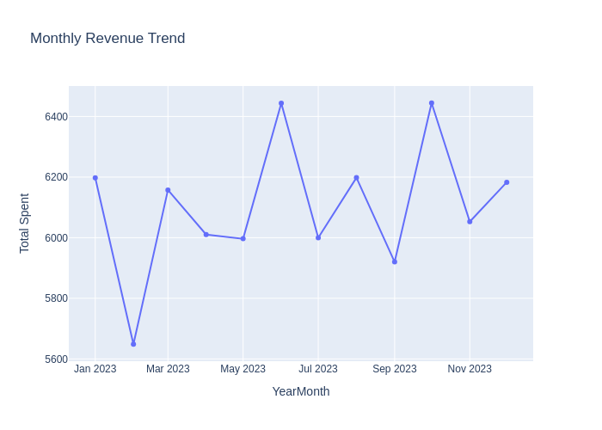
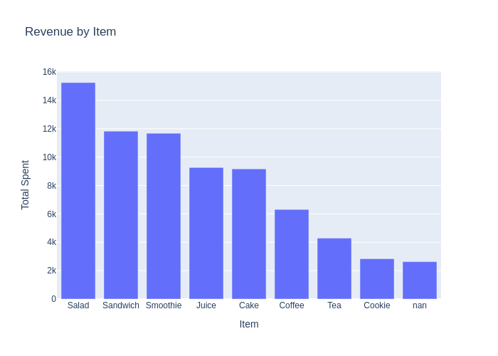
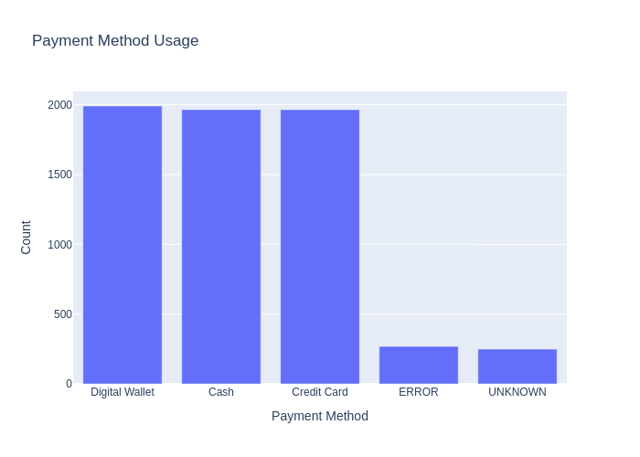
Cafe Sales Dashboard
Total Revenue: $73,252.50 | Transactions: 8,635 | Avg Ticket: $8.48

